Slide 1
Clustering Neighborhoods in Brasilia

Slide 2
Problem: Provide support to different visitors to list and visualize Brazilian districts that fit their needs in term of culinary venues.

Slide 3
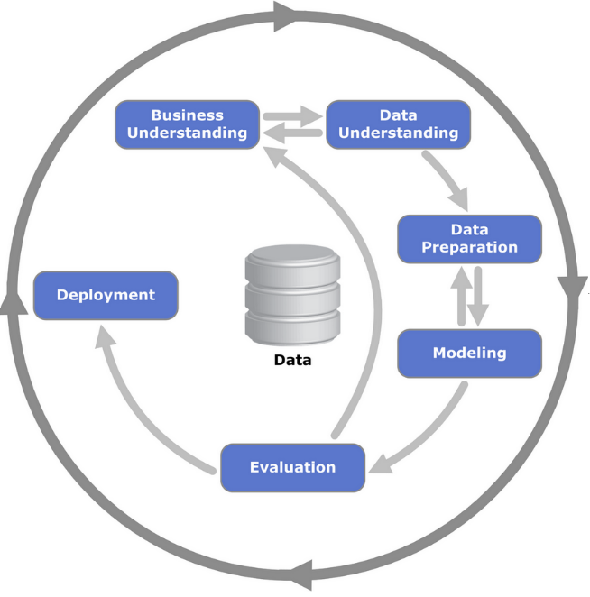
CRISP-DM

Slide 4
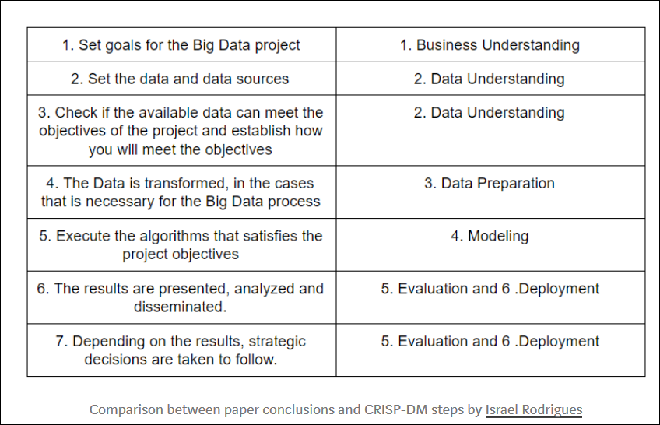
CRISP-DM

Slide 5
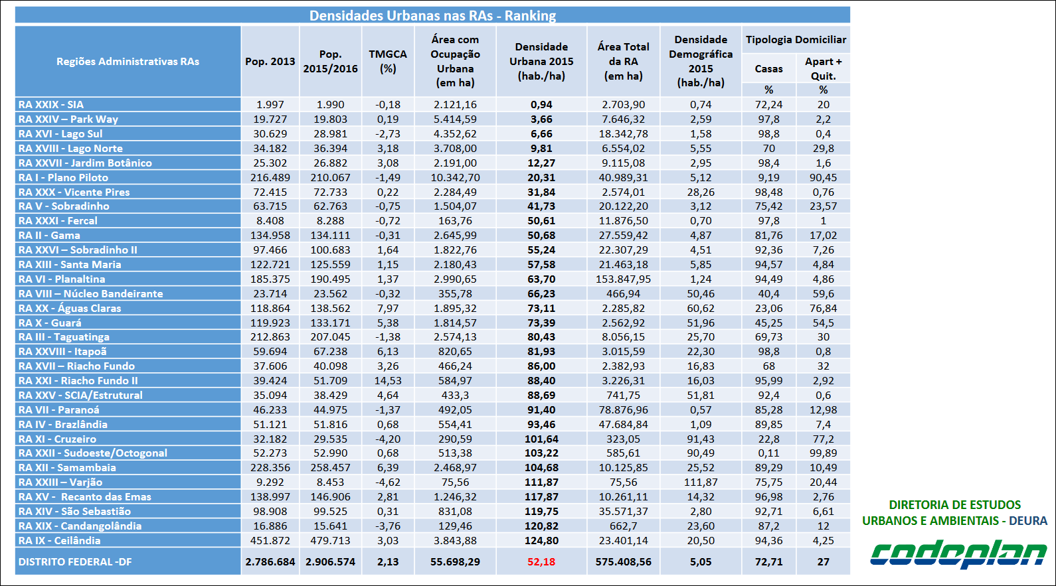
Data Requirements

Slide 6
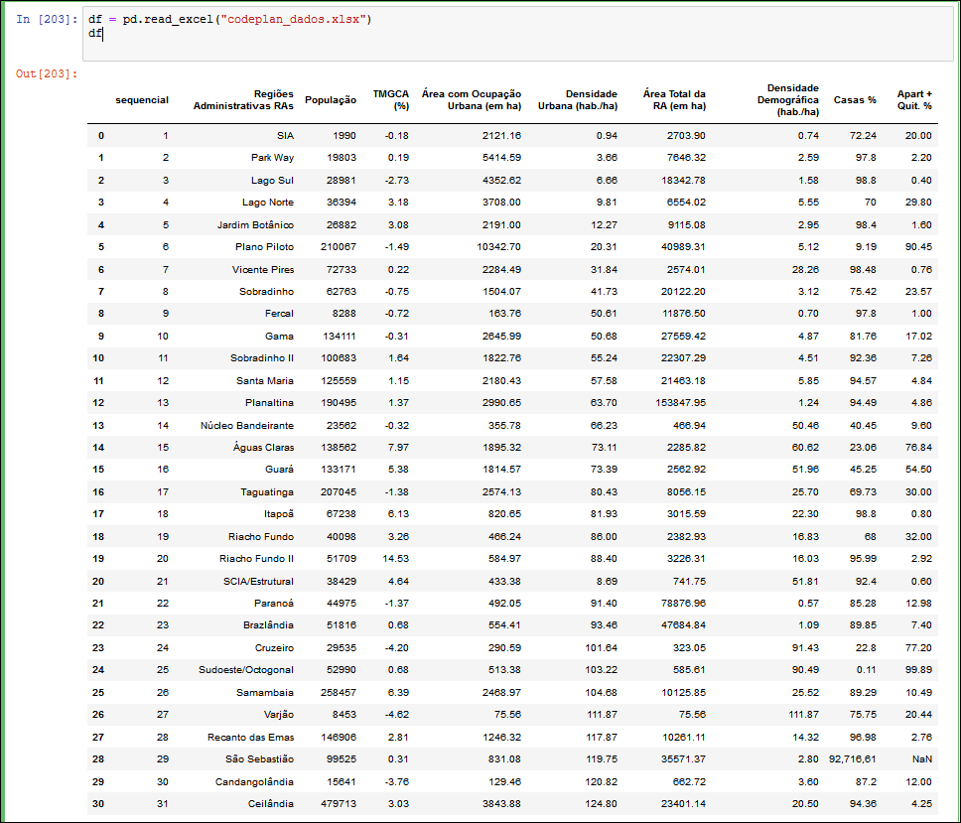
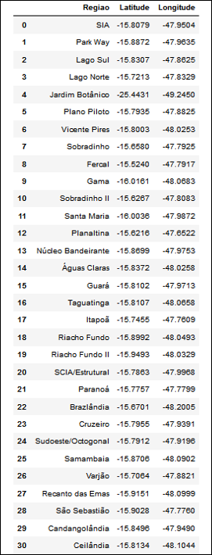
Dataframes

Slide 7
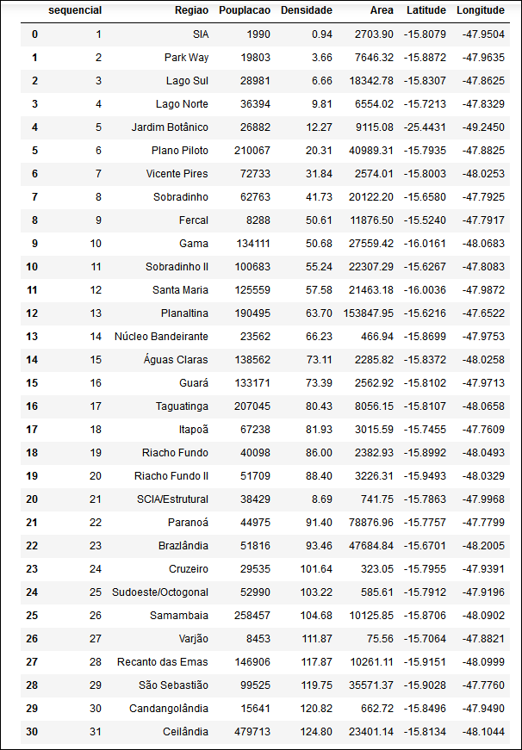
Data Manipulation (Join DataFrames)

Slide 8
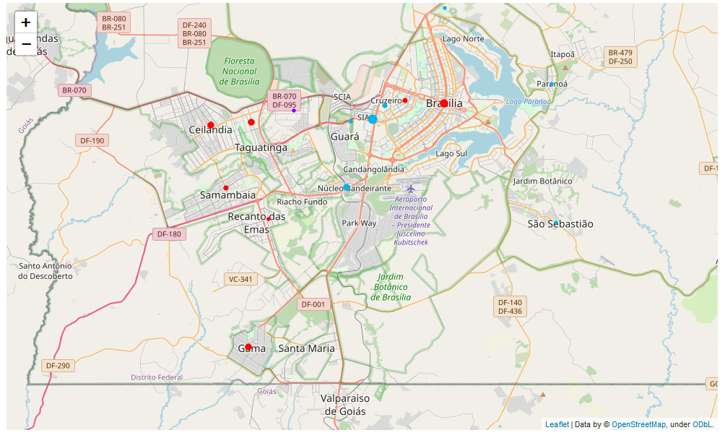
Python Folium Library

Slide 9
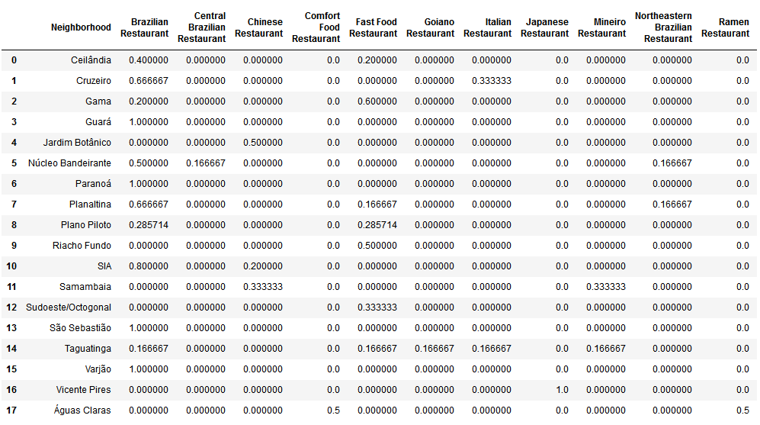
neighborhood column back to neighborhood column back to Neighborhood Column

Slide 10
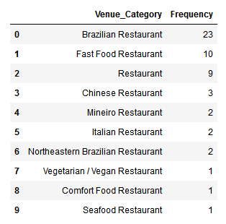
Foursquare and Sandwich Place Restaurants

Slide 11
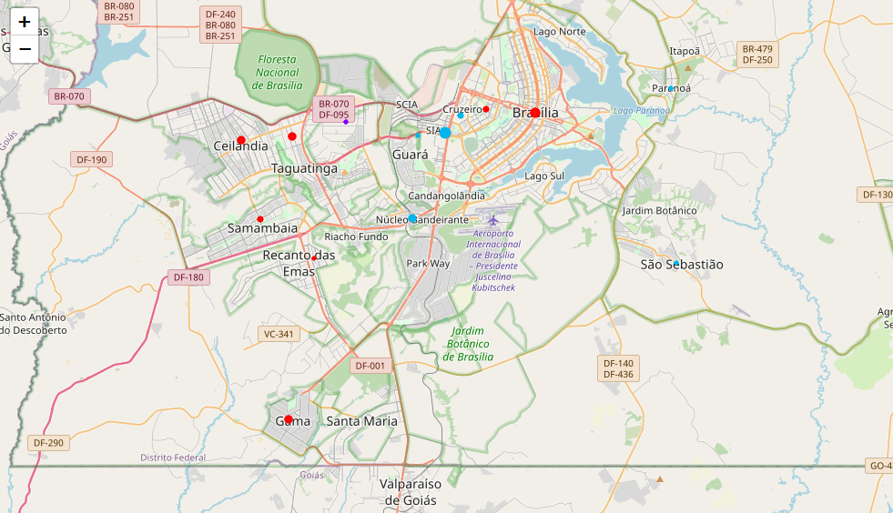
Represent Clusters

